Slide 1
7 Habits of Highly Effective People

Slide 2
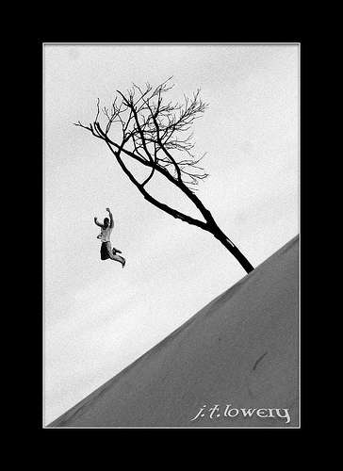
Habits have a tremendous gravity pull

Slide 3

Lift off takes a lot of effort,
but once we break out of the gravity pull,
our freedom takes on a whole new dimension

Slide 4
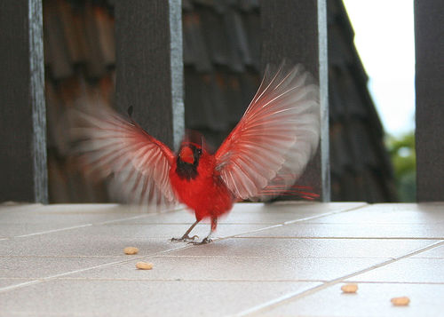
Ready for take off ?

Slide 5
Can we create a HABIT?
We are what we repeatedly do
Excellence, then, is not an act, but a habit
Habits are learned and unlearned
We are not the habits, hence we can change them

Slide 7
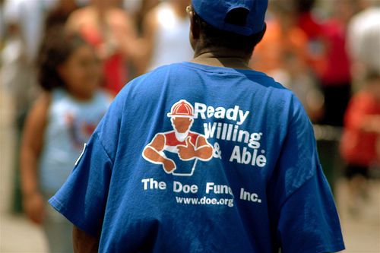
Habit 1:
Be proactive
积极主动
“You are respons-able: able to choose your response!”

Slide 8

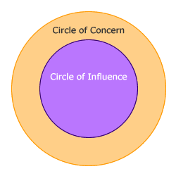
Circle of Concern
We have a wide range of concerns, but not all of them fall into our circle of influence
Circle of influence

Slide 9

“Proactive people focus on their efforts in their circle of influence, causing the circle of influence to increase
Reactive people focus their effort in the circle of concern. The negative energy generated by that focus causes the circle of influence to shrink”

Slide 10

“Anytime we think the problem is out there,
that thought is the problem”

Slide 11

You can choose your language
Reactive:
I must
If only
They made me
If I had
Proactive:
I prefer
I will
I choose
I can be

Slide 12
Habit 1
Effective People | Ineffective People
BE PROACTIVE | BE REACTIVE
Proactive people take responsibility for their own lives. They determine the agendas they will follow and choose their response to what happens around them. | Reactive people don’t take responsibility for their own lives. They feel victimized, a product of circumstances, their past, and other people. They do not see as the creative force of their lives.

Slide 13

Habit 2:
Begin with the end in mind
以终为始

Slide 14
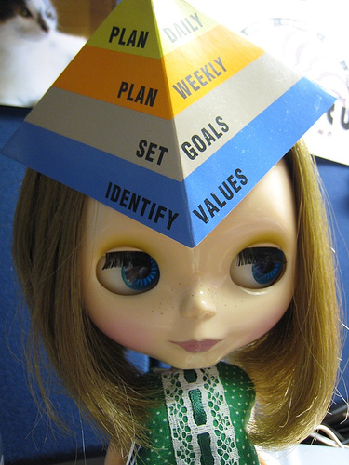

Slide 15
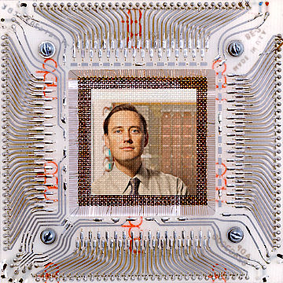
The key to the ability to change is a changeless sense of who you are, what you are about and what you value

Slide 16
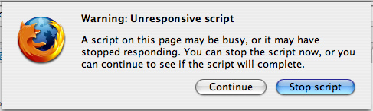
Is the script you are living in, in harmony with your values?

Slide 17
Habit 2
Effective People | Ineffective People
BEGIN WITH THE END IN MIND | BEGIN WITH NO END IN MIND
These people use personal vision, correct principles, and their deep sense of personal meaning to accomplish tasks in a positive and effective way. They live life based on self-chosen values and are guided by their personal mission statement. | These people lack personal vision and have not developed a deep sense of personal meaning and purpose. They have not paid the price to develop a mission statement and thus live life based on society’s values instead of self-chosen values.

Slide 18
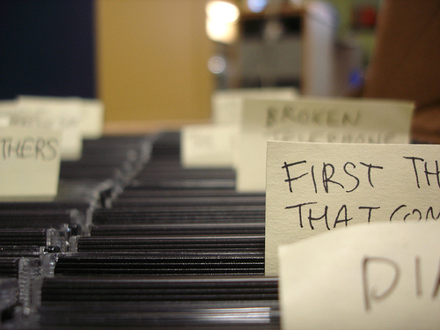
Habit 3:
Put first things first
要事第一

Slide 19
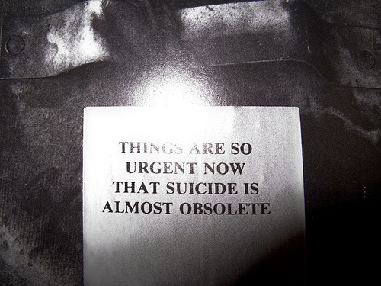

Slide 20
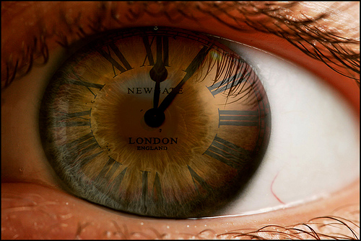
The key to time management is not to prioritize what’s on your schedule but to schedule your priorities

Slide 21

It’s almost impossible to say NO to the popularity of urgent, non important matters, if you don’t have a bigger YES burning inside

Slide 22
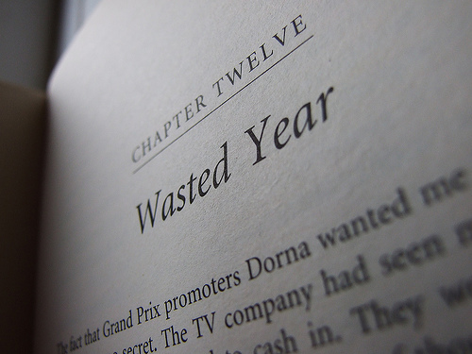
“Things which matter most should never be at the mercy of things which matter least”
Goethe

Slide 23
Habit 3
Effective People | Ineffective People
PUT FIRST THINGS FIRST | PUT SECOND THINGS FIRST
These people exercise discipline, and they plan and execute according to priorities. They also “walk their talk”. | These people are crisis managers who are unable to stay focused on high-leverage tasks because of their preoccupation with circumstances, their past, or other people. They are caught up in the “thick of thin things” and are driven by the urgent.

Slide 24

Habit 4: Think Win/win
双赢思维

Slide 25
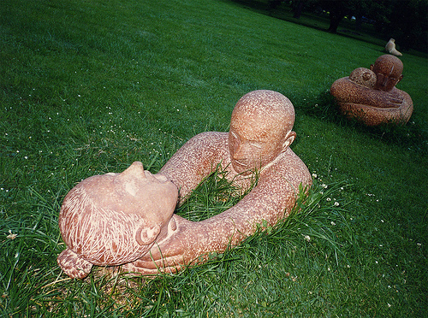
“You can only achieve win/win solutions with win/win processes”

Slide 26
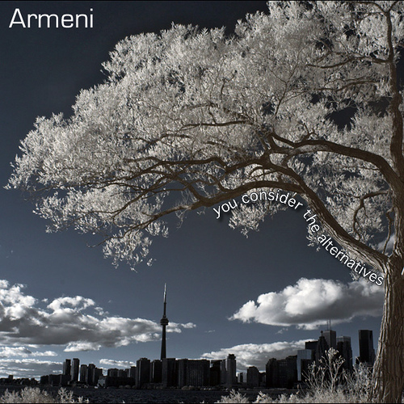
It’s not your way or my way, it’s a better way

Slide 27
High
Lose/Win
Win/Win
CONSIDERATION
Lose/Lose
Win/Lose
Low
Low
High
COURAGE

Slide 28
Habit 4
Effective People | Ineffective People
THINK WIN-WIN | THINK WIN-LOSE OR LOSE-WIN
These people have an abundance mentality and the spirit of cooperation. They achieve effective communication and high trust levels in their Emotional Bank Accounts with others, resulting in rewarding relationships and greater power to influence. | These people have a scarcity mentality and see life as a zero-sum game. They have ineffective communication skills and low trust levels in their Emotional Bank Accounts with others, resulting in a defensive mentality and adversarial feelings.

Slide 29
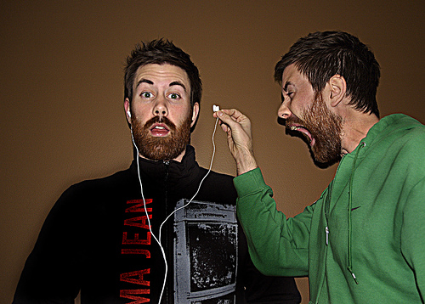
Habit 5:
Seek first to understand, then to be understood
知彼解己

Slide 30


Slide 31

“We have such a tendency to fix things up with good advice, but often we fail to take the time to diagnose, to really deeply understand another human being first”

Slide 32
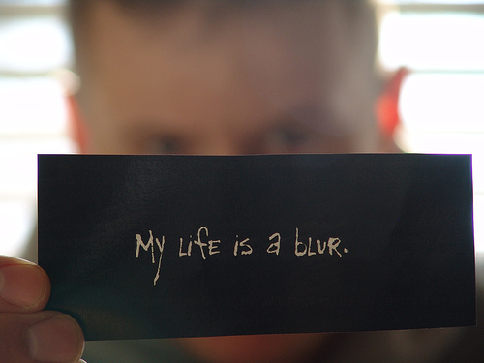
Reading your own autobiography into other people’s lives is nót (even close to) listening

Slide 33
Habit 5
Effective People | Ineffective People
SEEK FIRST TO UNDERSTAND THEN TO BE UNDERSTOOD | SEEK FIRST TO BE UNDERSTOOD
Through perceptive observation and empathic listening, these non-judgmental people are intent on learning the needs, interests, and concerns of others. They are then able to courageously state their own needs and wants. | These people put forth their point of view based solely on their auto-biography and motives, without attempting to understand others first. They blindly prescribe without first diagnosing the problem.

Slide 34

Habit 6:
Synergize
统合综效
“The whole is greater than the sum of its parts”

Slide 35

“When we are left to our own experiences,
we constantly suffer from a shortage of data”

Slide 36

“The person who is truly effective has the humility to recognize his own perceptual limitations and to appreciate the rich resources available through interaction with the hearts and minds of other human beings”

Slide 37

In order to have influence, you have to open yourself up to bé influenced

Slide 38
Habit 6
Effective People | Ineffective People
SYNERGIZE | COMPROMISE, FIGHT OR FLIGHT
Effective people know that the whole is greater than the sum of the parts. They value and benefit from differences in others, which results in creative cooperation and team-work. | Ineffective people believe the whole is less than the sum of the parts. They try to “clone” other people in their own image. Differences in others are looked upon as threats.

Slide 39

Habit 7:
Sharpen the Saw
不断更新

Slide 40

Read, write, relax, exercise, play, love, get involved, meditate …

Slide 41
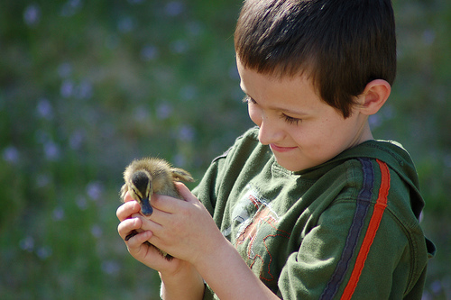
“Sometimes when I consider what tremendous consequences come from little things … I am tempted to think … there are no little things”
Bruce Barton

Slide 42
Habit 7
Effective People | Ineffective People
SHARPEN THE SAW | WEAR OU T THE SAW
Effective people are involved in self-renewal and self-improvement in the physical, mental, spiritual, and social-emotional areas, which enhance all areas off their life and nurture the other six habits. | Ineffective people fall back, lose their interest, and get disordered. They lack a program of self-renewal and self-improvement and eventually lose the cutting edge they once had.

Slide 43
7 Principles Upon which the 7 Habits are Based
The 7 habits center on the timeless and universal principles of:
Personal
Interpersonal
Managerial
Organizational Effectiveness

Slide 44
7 Principles Upon which the 7 Habits are Based
The principle of continuous learning, of self-education - the discipline that drives us toward the values we believe in. Such constant learning is required in today’s world, in light of the fact that many of us can expect to work in up to five radically different fields before we retire
The principle of service, of giving oneself to others, of helping to facilitate other people’s work
The principle of affirmation of others - treating people as proactive individuals who have great potential

Slide 45
7 Principles Upon which the 7 Habits are Based
The principle of staying positive and optimistic, radiating positive energy - including avoiding the four emotional cancers (criticizing complaining, comparing and competing)
The principle of balance - the ability to identify our various roles and to spend appropriate amounts of time in, and focus on, all the important roles and dimensions of our life. Success in one area of our life cannot compensate for neglect or failure in other areas of our life.

Slide 46
7 Principles Upon which the 7 Habits are Based
The balance of spontaneity and serendipity - the ability to experience life with a sense of adventure, excitement, and fresh rediscovery, instead of trying to find a serious side to things that have no serious side.
The principle of consistent self-renewal and self-improvement in the four dimensions of one’s life: physical, mental, spiritual, and social - emotional.

Slide 47
4 Unique Human Endowments
Self Awareness:
We begin to become self-aware and explore the programs we are living out. We come to realize that we stand apart from our programming and can even examine it. We also realize that between stimulus and response, we have the freedom to choose. This self-awareness then leads to the ability to look at other unique endowments in our secret life.

Slide 48
4 Unique Human Endowments
Conscience:
Our conscience is our internal sense of right and wrong, our “moral nature.” It is the “greater harmonizer” and “balance wheel” of all the principles that govern our behavior. Our conscience gives us a sense of the degree to which our thoughts and actions are in harmony with our principles.

Slide 49
4 Unique Human Endowments
Power of Imagination:
We can visit the power of the mind to create or to imagine that which does not exist now. In that imagination lie our faith and our hope for the future. We look at what is possible, what we can envision.

Slide 50
4 Unique Human Endowments
Will Power or Independent Will:
Willpower refers to our determination, our resoluteness - our ability to act based solely on our self-awareness. We ask ourselves, “Am I really willing to the distance on my mission statement?” “Am I willing to walk my talk?” “Am I really willing to put first things first in spite of external distractions and pressures?” “Am I going to live a life of total integrity?”

Slide 51
Paradigm Shift
HABIT | A BREAK FROM TRADITIONAL WISDOM | TOWARD 7 HABITS PRINCIPLES
Habit 1 | We are a product of our environment and upbringing. | We are a product of our choices to our environment and upbringing.
Habit 2 | Society is the source of our values. | Values are self-chosen and provide foundation for decision making. Values flow out of principles.
Habit 3 | Reactive to the tyranny of the urgent. Acted upon by the environment. | Actions flow from that which is important.
Habit 4 | Win-lose. One-sided benefit. | Win-win. Mutual benefit.
Habit 5 | Fight, flight, or compromise when faced with conflict. | Communication solves problems.
Habit 6 | Differences are threats. Independence is the highest value. Unity means sameness. | Differences are values and are opportunities for synergy.
Habit 7 | Entropy. Burnout on one track - typically work. | Continuous self-renewal and self-improvement.

Slide 52
Urgent
Not Urgent
I
II
. Crisis
. Pressing problems
. Deadline-driven projects, meetings, preparations
. Preparation
. Prevention
. Values clarification
. Planning
. Relationship building
. True re-creation
. Empowerment
Important
III
IV
. Interruptions, some
phone calls
. Some mail, some reports
. Some meetings
. Many proximate,
pressing matters
. Many popular activities
. Trivia, busywork
. Some phone calls
. Time wasters
. “Escape” activities
. Irrelevant mail
. Excessive TV
Not Important

Slide 53

Personal Immune System
Time wasters
Duplicity
Live the Seven Habits
Interruptions
Unkindness
Spend time
in Quadrant II
Maintain reserve
capacity
Be resilient
Violated
expectations
Pressing
problems
Follow correct
principles
Empower and
serve others
Control own life
Communicate
Empathically
Crisis
Outside stress
and pressures
Maintain high
Emotional Bank
Account with self
and others
Synergize with
others using a
win-win approach

